Slide 1
What is a Website?
Introduction to Programming
Midori Kocak - August 2018

Slide 2
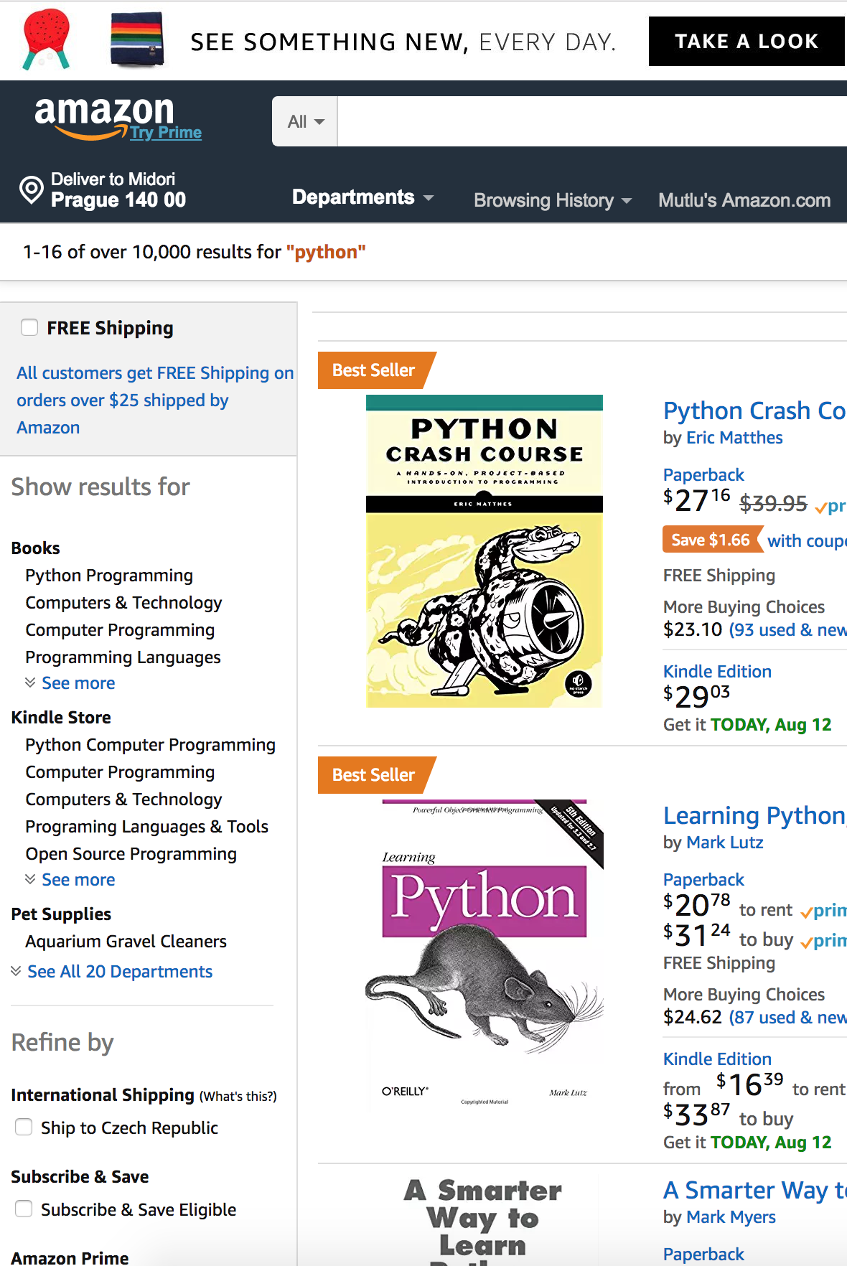

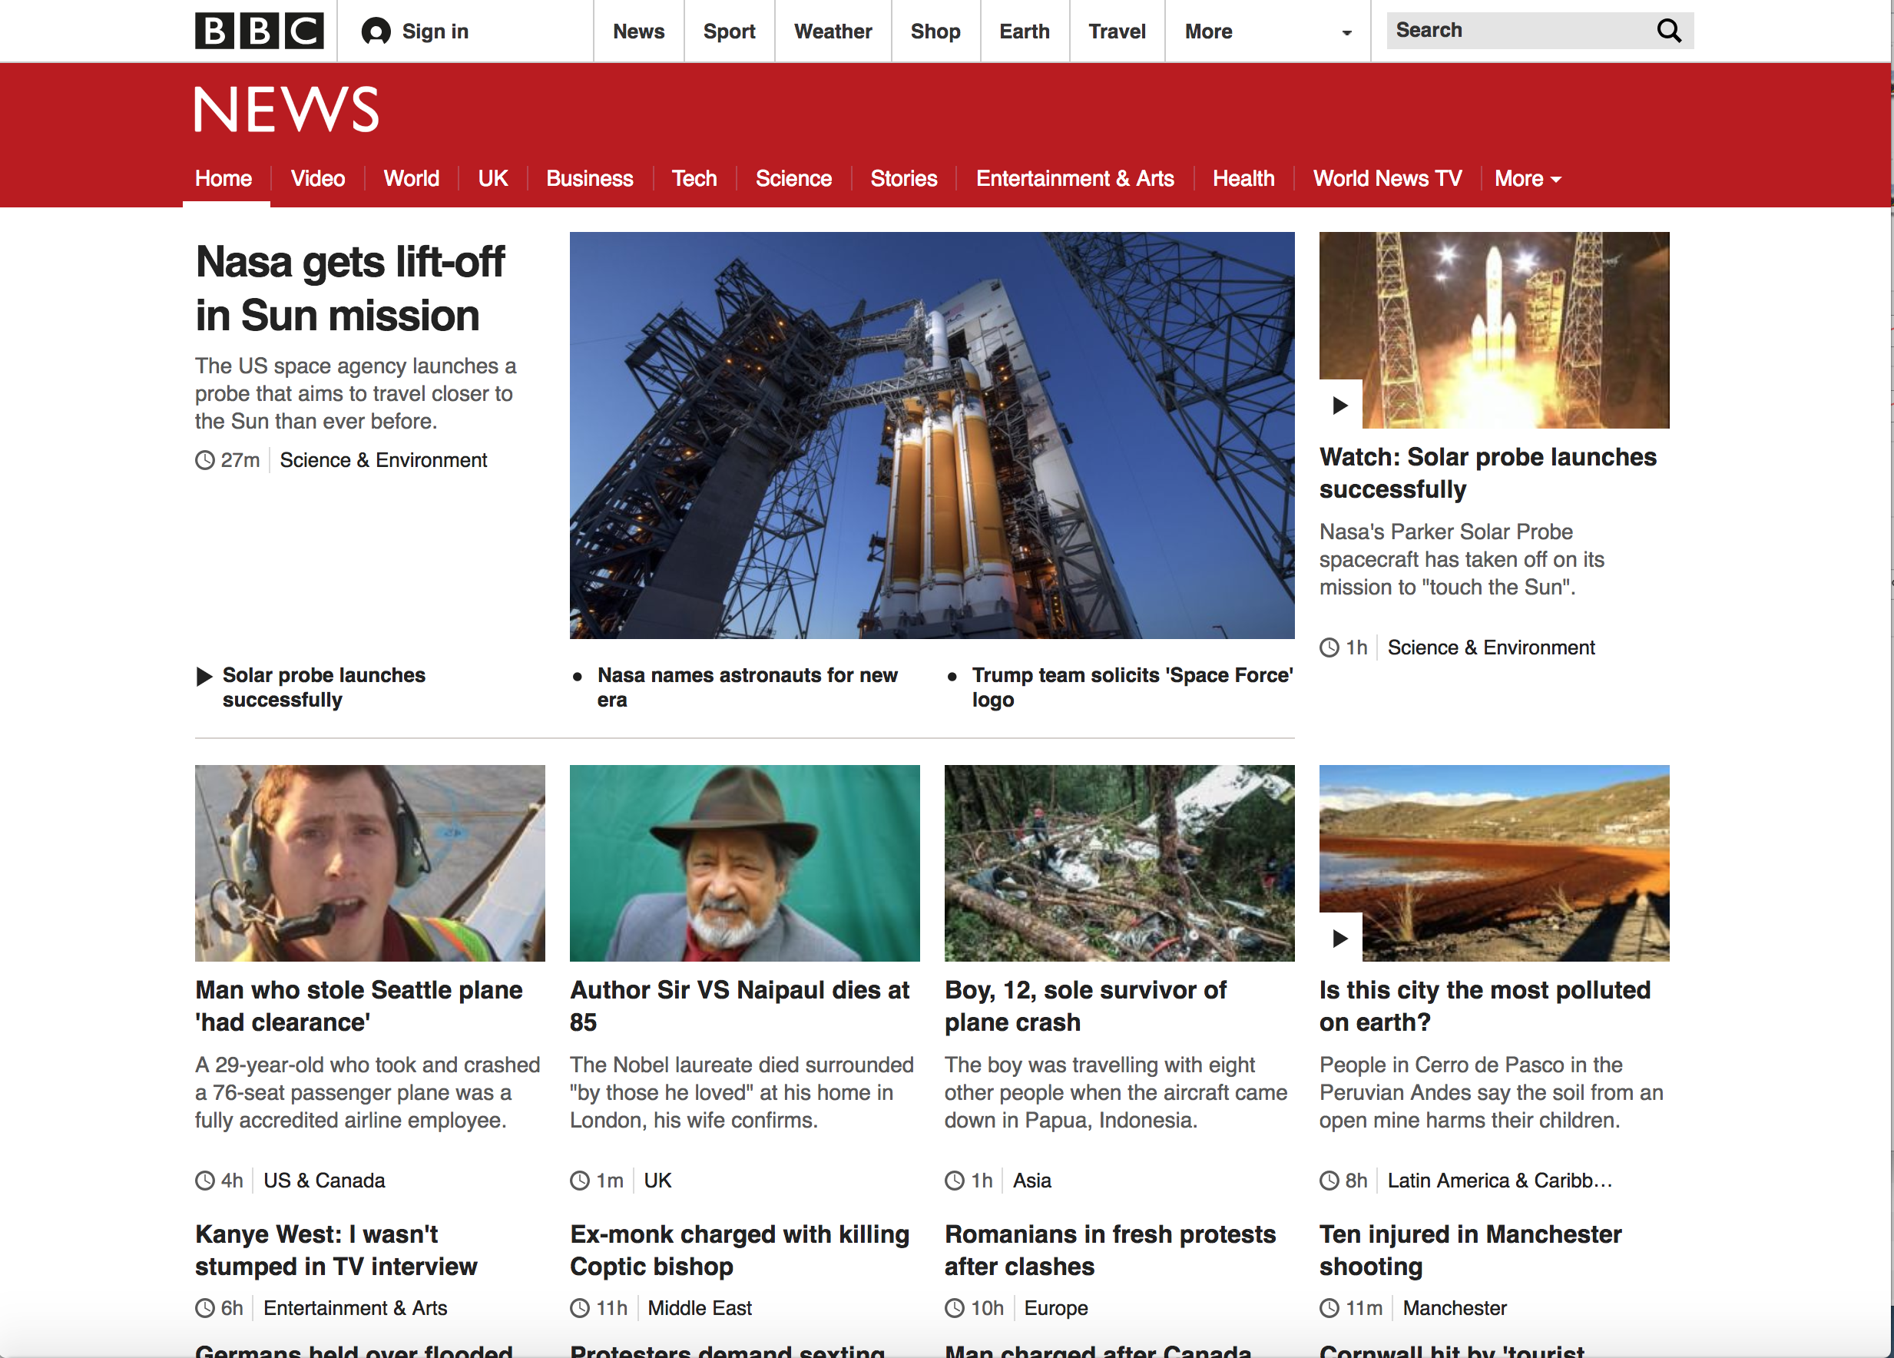

Slide 3
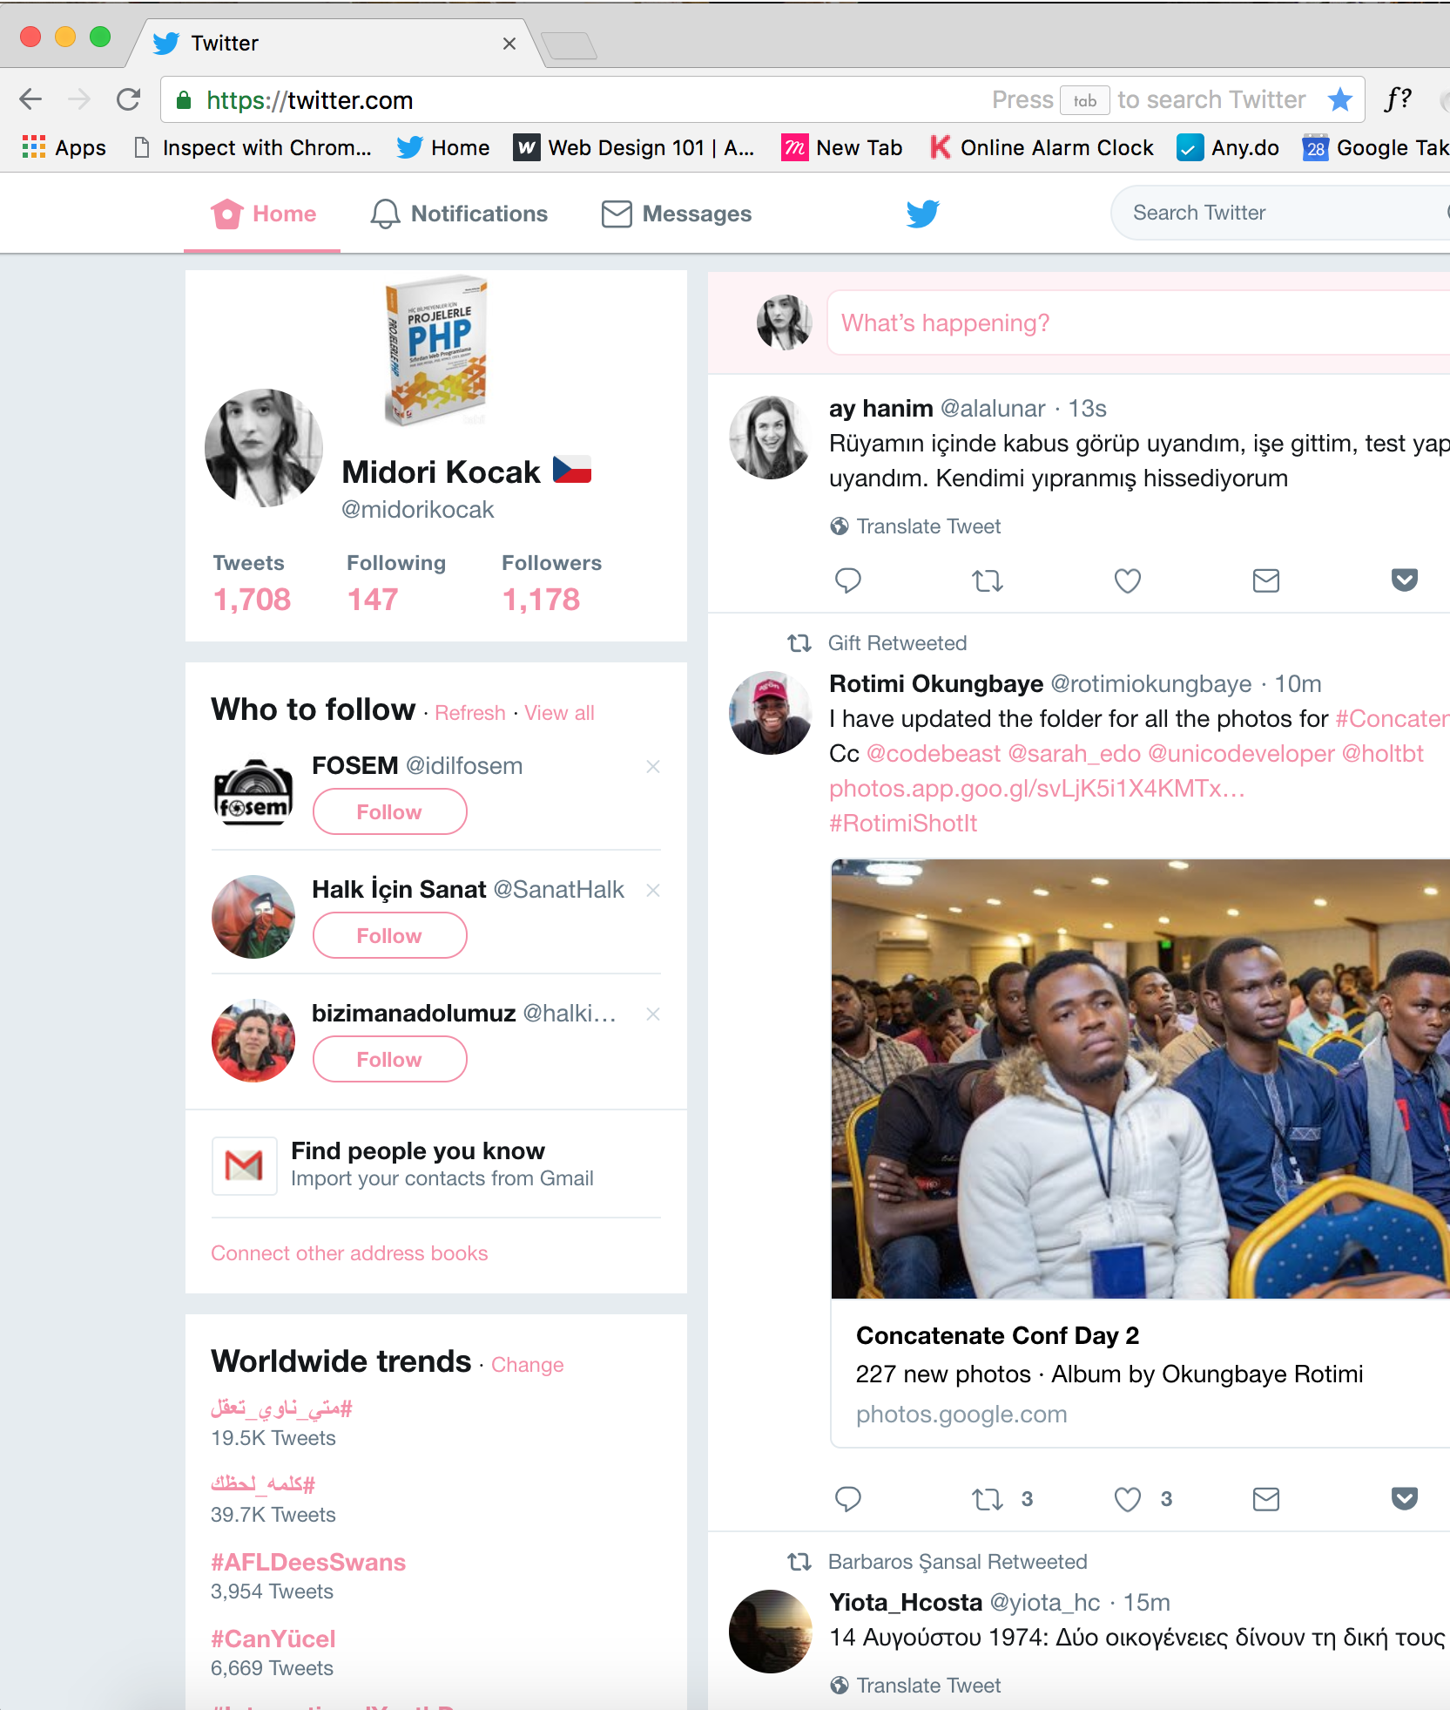
Description
A website is a collection of related web pages, including multimedia content, typically identified with a common domain name, and published on at least one web server.
A webpage is a document which can be displayed in a web browser such as Firefox, Google Chrome, Opera, Microsoft Internet Explorer or Edge, or Apple's Safari. These are also often called just “pages.”
A web server is a computer that hosts a website on the Internet.

Slide 4
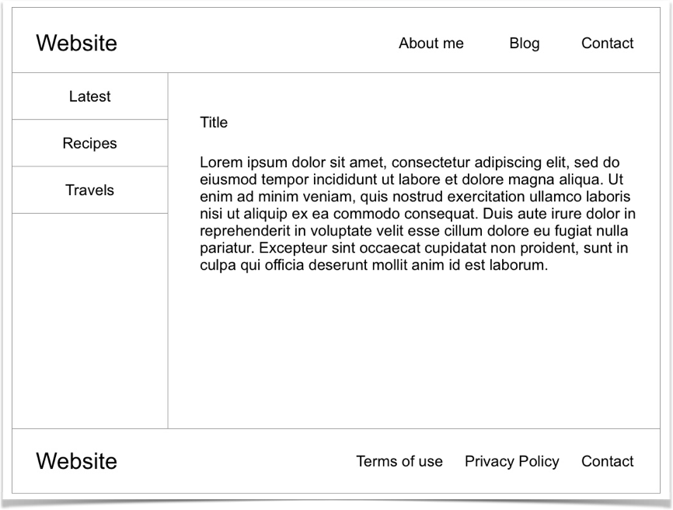
Webpage

Slide 5
Header
Webpage

Slide 6
Header
Logo
Webpage

Slide 7
Header
Logo
Nav
Webpage

Slide 8
Header
List of Links
Logo
Nav
Webpage

Slide 9
Header
List of Links
Logo
Nav
A sidebar
Webpage

Slide 10
Header
List of Links
Logo
Nav
A sidebar
List of Links
Webpage

Slide 11
Header
List of Links
Logo
Nav
A sidebar
Main content area
List of Links
Webpage

Slide 12
Header
List of Links
Logo
Nav
A sidebar
Main content area
Article
List of Links
Webpage

Slide 13
Header
List of Links
Logo
Nav
A sidebar
Main content area
Article
List of Links
Webpage

Slide 14
Header
List of Links
Logo
Nav
A sidebar
Main content area
Article
List of Links
Paragraph
Webpage

Slide 15
Header
List of Links
Logo
Nav
A sidebar
Main content area
Article
List of Links
Paragraph
Footer
Mostly boring stuff
Webpage

Slide 16
Header
List of Links
Logo
Nav
A sidebar
Main content area
Article
List of Links
Paragraph
Footer
Mostly boring stuff
Logo
List of Links
Webpage

Slide 17

Hypertext Markup Language (HTML) is the standard markup language for creating web pages and web applications. With Cascading Style Sheets (CSS) and JavaScript, it forms a triad of cornerstone technologies for the World Wide Web.[4]
Marking means wrapping content to tags.
Is a subset of XML (Extensible Markup Language)

Slide 18
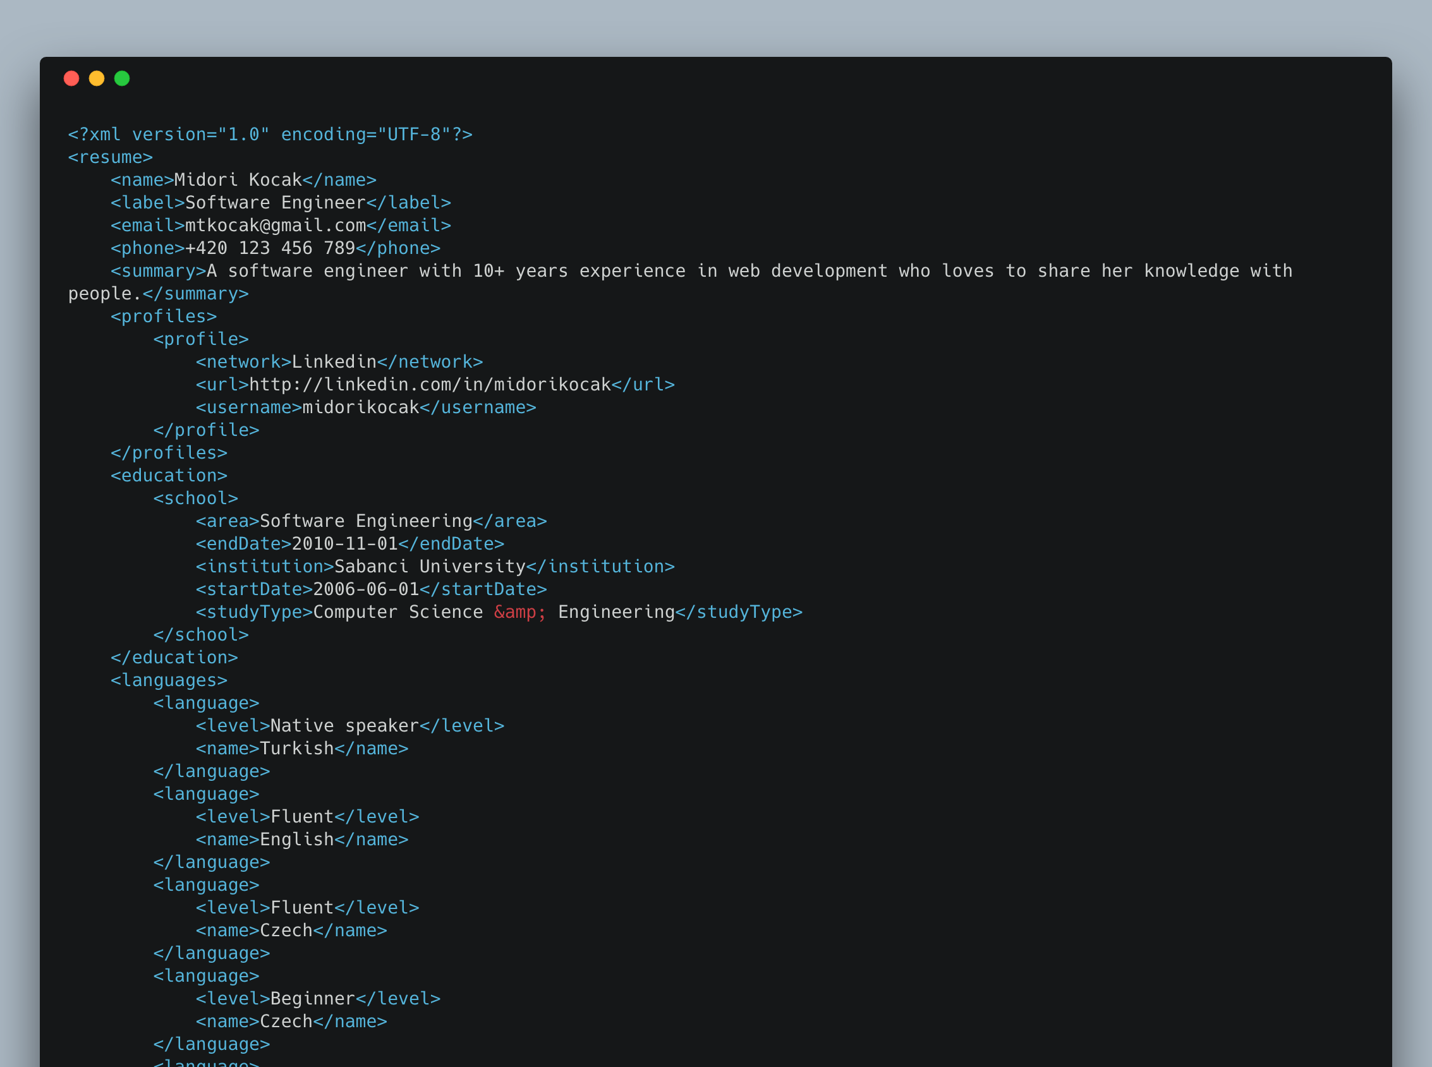

Slide 19
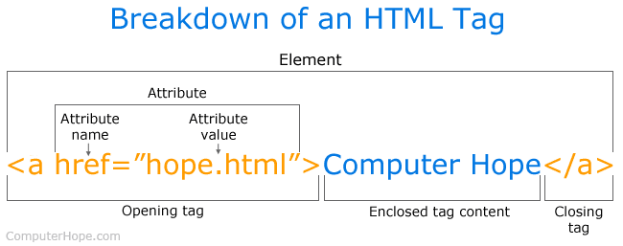

Slide 20
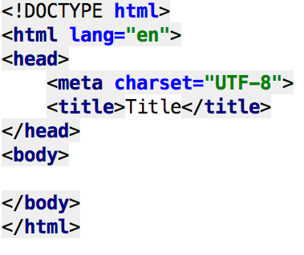
Empty HTML Page
The first thing on an HTML page is the doctype, which tells the browser which version of the markup language the page is using.
After <doctype>, the page content must be contained between <html> tags.
Head: The head contains the title of the page & meta information about the page. Meta information is not visible to the user, but has many purposes, like providing information to search engines.
Body: The body contains the actual content of the page. Everything that is contained in the body is visible to the user.
Source: http://girldevelopit.github.io/gdi-featured-html-css-intro/class1.html#/1

Slide 21
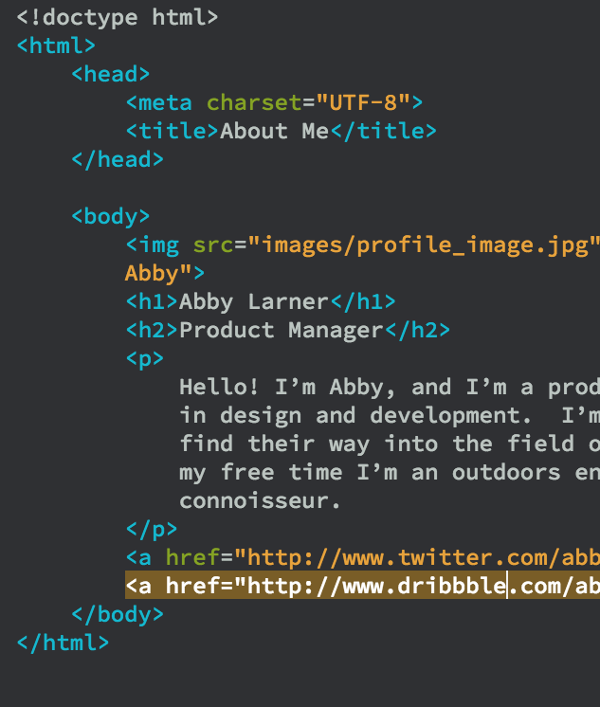
Tags we use most
<h1>Title<h1> A heading. Used for titles
<p>Paragraph<p> Used for praragraphs.
<a href=“http://linkedin.com”>LinkedIn</a> Used for giving linki to other webpages.
<img src=“midori.jpg” /> Shows images. It doesn’t close. (A stadanlone tag)

Slide 22
Tags we use most
<b>Bold Text<b> Makes a text bold
<i>Italic text<i> Makes a text italik
<div>Content</div> Used to separate and style contents.

Slide 23
Let’s develop an example using basic tags

Slide 24
Development Environment
Download editor you like. Sublime Text, Notepad++, Atom, VS Code or Text Mate.
Create a /src holder in your home directory. You will keep projects here.
Create /learn-html folder under /src folder. Inside that folder create /img /js /css folders and an empty index.html page.
Open index.html page in your editor.

